Slide 1
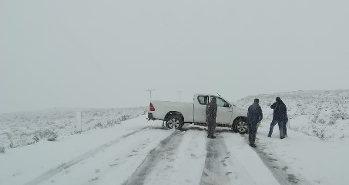
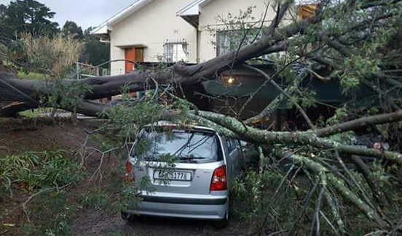
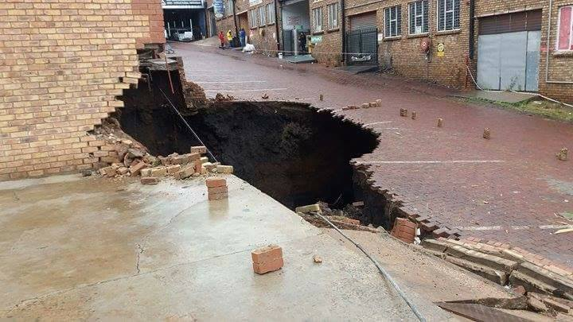

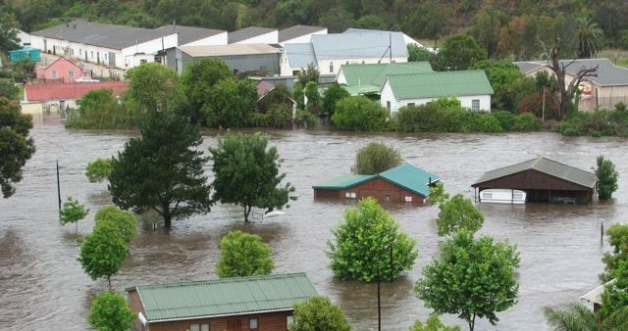
Project on
Developing and Implementing
an Impact-based
Severe Weather Warning System
South African Weather Service
and
National Disaster Management Centre

Slide 2
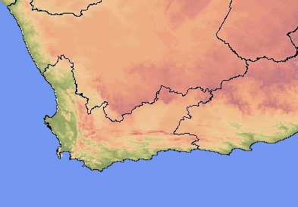
What is it about?
Current Warning:
Heavy rain of more than 50mm in 24 hours is expected
So??
What does it mean to me?

Slide 3
International Developments?
WMO: Disconnect between warning of hydromet events, and the understanding of their impacts
‘Weather warnings need to be more tailored towards the end-user’ (KNMI)
‘Weather warnings should only be issued if severe weather is expected to have an impact’ (UK)
IMPACT-BASED WARNINGS
UK implemented in 2011
WMO Guidelines (latest version 2015)
Europe, USA, Australia in various versions
Pilot projects by WMO in Myanmar, Mauritius, Mozambique, Malaysia, etc.

Slide 4
Subsequent SA Disaster Management Survey and meetings (in 2013)
Challenge from Disaster Managers:
  Clear requirement of matter-of-fact information, i.e non-scientific and to the point – minimize need for complex interpretation
  The need for improving communication to users to enable their effective decision making
  “Just tell me what is going to happen, when, where and how serious it is”

Slide 5
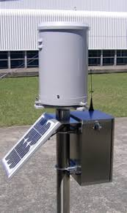
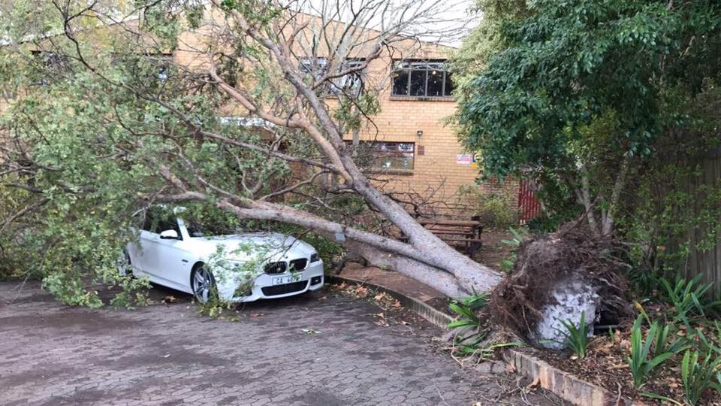
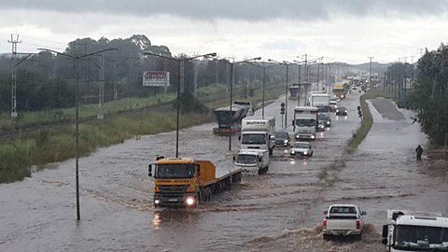

What is Impact-Based forecasting?
To:
Moving from:
What the weather will be: (Meteorological thresholds)
- 50mm in 24 hours
- 35 knot winds
What the weather will do:
(Impact Warnings)
- Roads flooded
- Communities cut off

Slide 6
We need to change from this to….
Current Warning:
Heavy rain of more than 50mm in 24 hours is expected

Slide 7
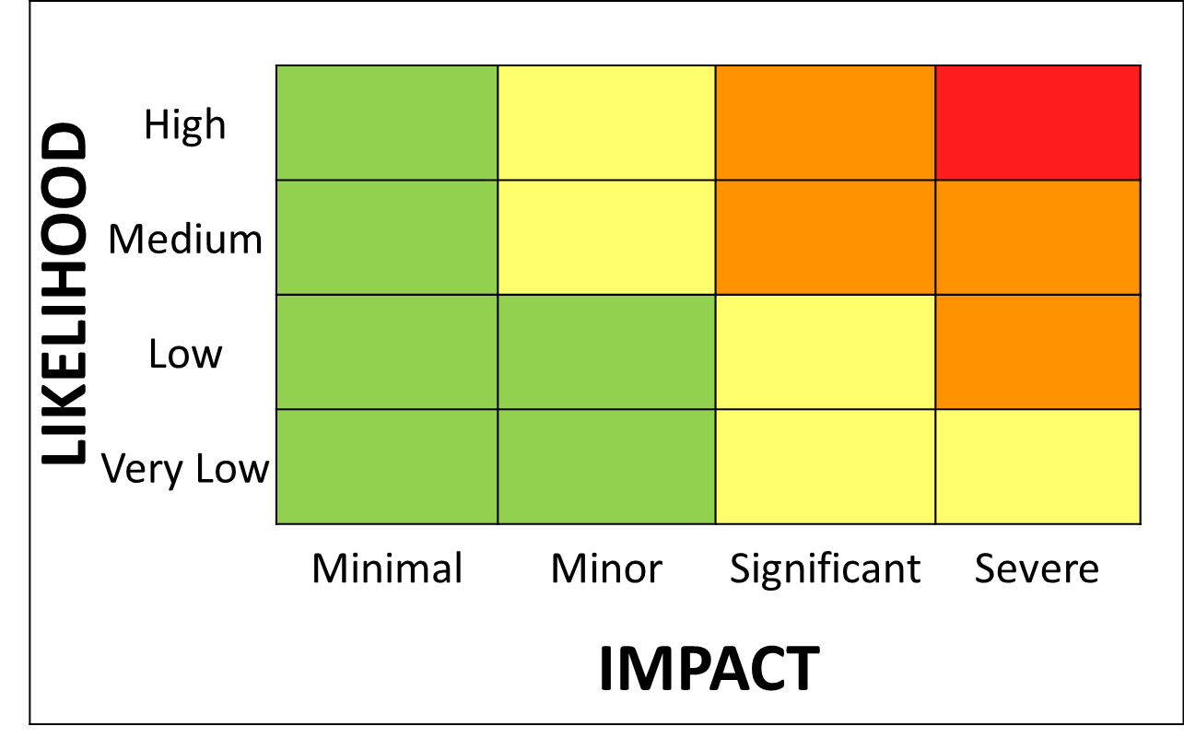
An impact-based Early Warning System
Warning:
1. Orange warning for rain with a medium likelihood of significant impacts
2. Yellow warning for rain with a high likelihood of minor impacts
2
1
2
1

Slide 8
  So, how does it work?
Impact tables helps with high-level distinguishing between less severe and more severe impact levels
Impact level depends on vulnerability in local area to impacts
Content determined by collective disaster management input
Generic description of different impact levels
Minimal | Minor | Significant | Severe
Day to day activities not affected but some small scale impacts occur | Some local incidents, minor disruptions, 'business as usual' for emergency responders | Disruption to day to day routines and activities, mostly localised. Short-term strain on emergency responder organisations | Widespread, Prolonged disruption to day to day routines and activities Prolonged strain on emergency responders organisations.
Notes:
Put in rainfall impact table

Slide 9
Likelihood | High |  | 2 | 6 | 10
 | Medium |  | 1 | 5 | 9
 | Low |  |  | 4 | 8
 | Very Low |  |  | 3 | 7
 |  | Minimal | Minor | Significant | Severe
 |  | Impact

Slide 10
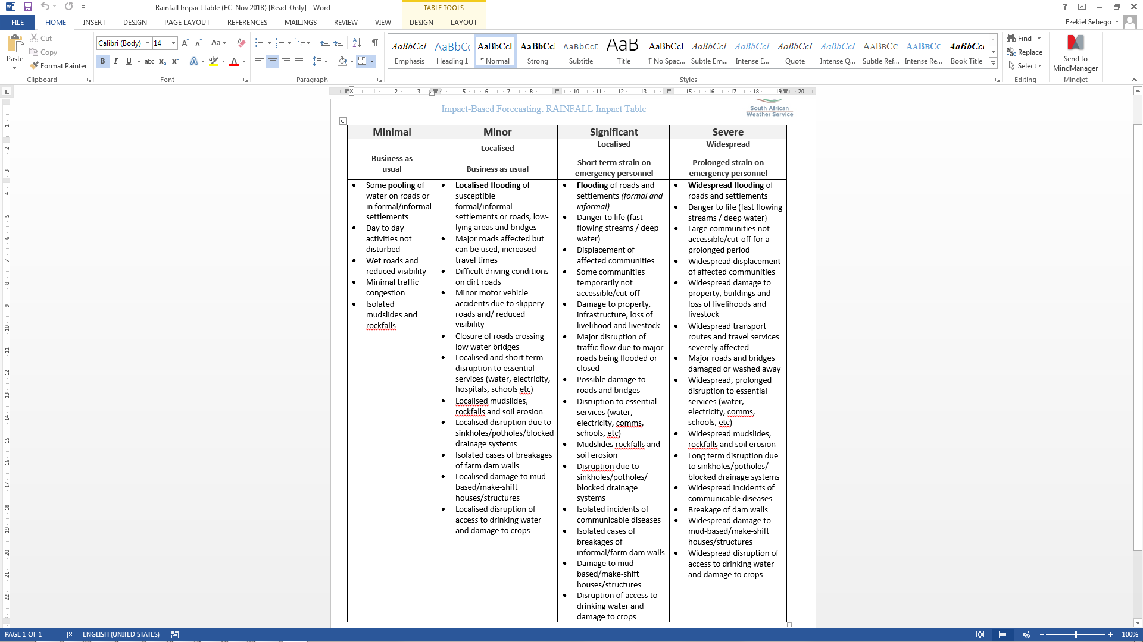
  Example of Impact table
Notes:
Check recent events in KZN

Slide 11
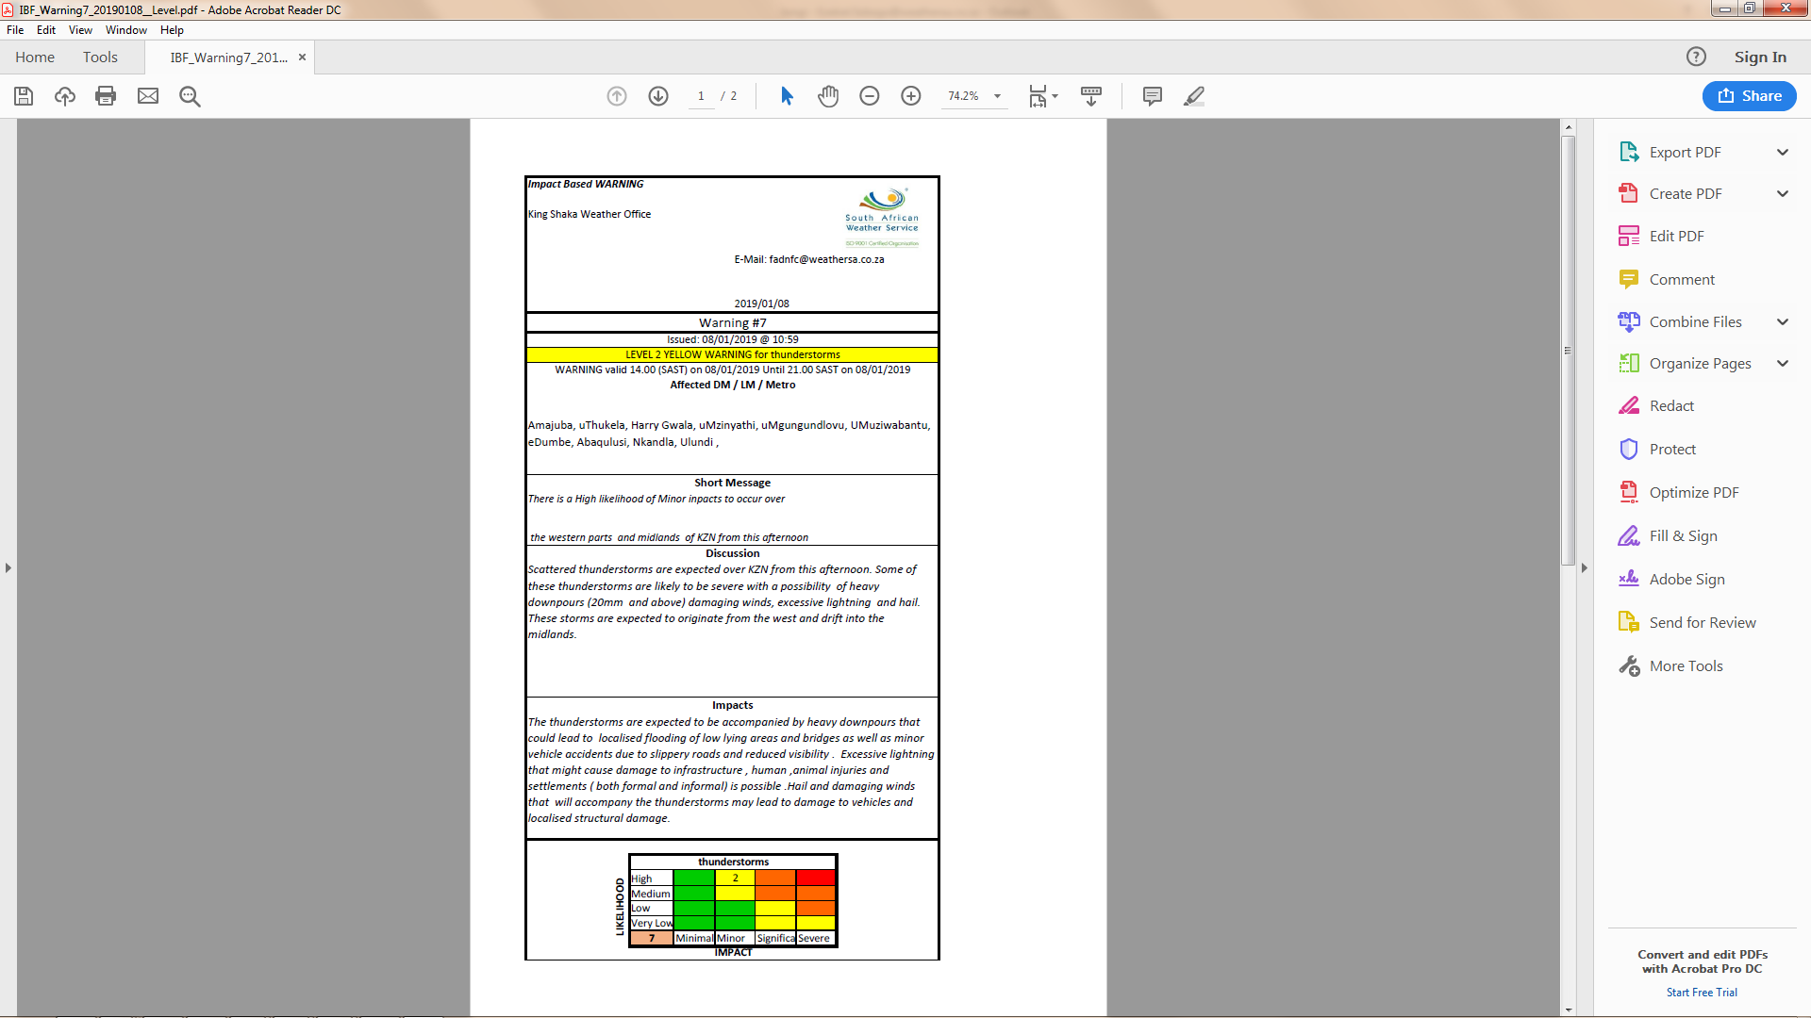
  Example of Impact-based warning
Notes:
Check recent events in KZN

Slide 12
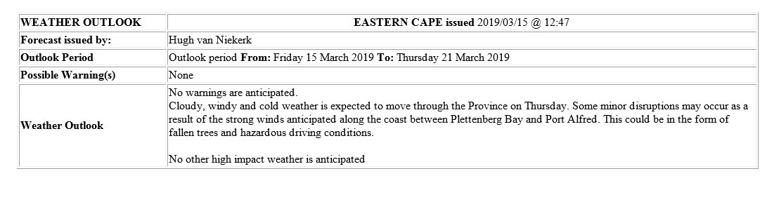
  Other IBF products
Weekly outlooks will be sent to DM from each weather forecasting office to give an overview of the following 7 days

Slide 13
  Integrated “end-to-end” EWS
SAWS monitoring weather &
initiate alerts
Coordination
PDMCs, MDMCs impact assessment
Large Scale weather patterns
Impact-Based SWWS
Warnings issued:
Yellow, orange, red
National, regional,
local scale weather impacts
DM structures
Media
Dissemination platforms
CB EWS
Community, “house” scale social impacts
Rural villages,
informal settlements, Communities
Cities,
Towns

Slide 14
  Conclusion
      It is a user oriented, easy to understand, risk-based Early Warning System, adapted for South African conditions.
      It will result in a joint ownership of warnings (system involves participation of DM before issuance of Orange and Red warnings)
      This concept has been introduced in DRR, can be extended to other spheres like energy, agriculture, retail etc.
      These warnings will replace the current warning system from mid-May.
      Future developments will include the use of GIS-based vulnerability data to pin-point areas at highest risk.
      Warning verification methods to be developed.

Slide 15
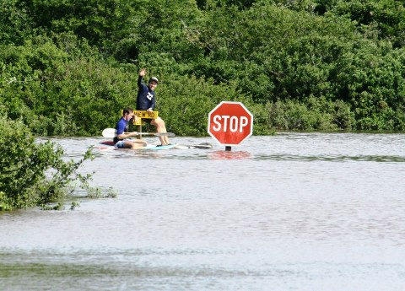
Thank You

